Slide 1
C-Store: Introduction to TPC-H
Jianlin Feng
School of Software
SUN YAT-SEN UNIVERSITY
Mar 20, 2009

Slide 2
Overview of TPC-H
What’s TPC?
  Transaction Processing Performance Council.
  http://www.tpc.org/
TPC-H is an ad-hoc, decision support benchmark.
  business oriented ad-hoc queries
  concurrent data modifications

Slide 3
So Called “What if” Query: An Example
Tell me
  the amount of revenue increase that would have resulted from eliminating certain company-wide discounts in a given percentage range in a given year.

Slide 4
The Example Query in SQL
-- $ID$
-- TPC-H/TPC-R Forecasting Revenue Change Query (Q6)
-- Functional Query Definition
-- Approved February 1998
:x
:o
select
sum(l_extendedprice * l_discount) as revenue
from
lineitem
where
l_shipdate >= date ':1'
and l_shipdate < date ':1' + interval '1' year
and l_discount between :2 - 0.01 and :2 + 0.01
and l_quantity < :3;
:n -1

Slide 5
The History
In April 1999, TPC-R and TPC-H replaced TPC-D.
TPC-R is for a reporting workload.
  Queries are well known in advance.
  Obsolete as of 1/1/2005
TPC-H is for an ad-hoc querying workload.
  Queries are not known in advance.
TPC-H 2.8.0 (Now)
  http://www.tpc.org/tpch/spec/tpch2.8.0.pdf

Slide 6
Business Environment
TPC-H and TPC-R model
  any industry which manages, sells, or distributes products worldwide
  Such as parts, food distribution
Business Environment is divided into two areas:
  A Business Operation area
  A Decision Support area

Slide 7
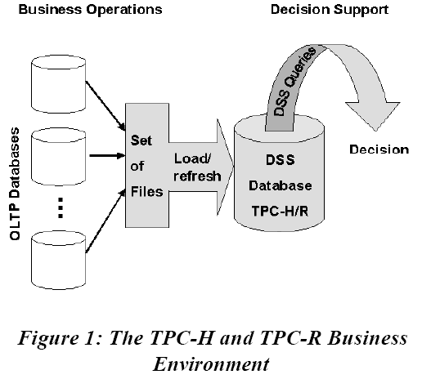

Slide 8
Purpose of Benchmarks
To reduce the diversity of operations found in a typical decision support application
While retaining the application’s essential performance characteristics:
  The level of system utilization
  And the complexity of operations.

Slide 9
The Core of TPC-H/R
A set of business queries designed to exercise system functionalities in complex decision support applications.
These queries portray the activity of a wholesale supplier to help the audience relate intuitively to the components of the benchmarks.

Slide 10
Target Domain of Business Analysis
Pricing and Promotions;
Supply and Demand Management;
Profit and Revenue Management;
Customer Satisfication Study;
Market Share Study;
Shipping Management.

Slide 11
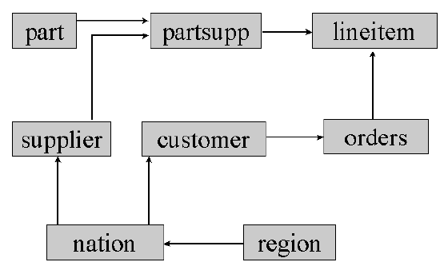
Schema
Both TPC-H and TPC-R use 3rd Normal Form.
  8 base tables

Slide 12
dbgen: the Data Generator http://www.tpc.org/tpch/spec/tpch_2_8_0.zip
Generates data for all base tables
  Depending on a scale factor (SF).
The scale factor determines the size of raw data inside the databse
  SF=100 means that the sum of all base tables equals 100 GB.
  Fixed choices of SF: 1, 10, 30, 100, 300, 1000, 3000, 10000
The size of each table scales up with the SF.
  Except for nation and region

Slide 13
Workload
A database load
The execution of 22 read-only queries in both single and multi-user mode.
The execution of 2 refresh functions

Slide 14
Database Load
Is the process of building the test database.
The database load time includes all of the elapsed time
  to create the tables, load data,
  ceate indices, define and validate constraints,
  gather statistics, configure the system,
  and ensure that the test database meets the ACID requirements.

Slide 15
22 read-only queries:
Characterized by 4 components
A business question
  illustrates the business context in which the query is used.
A functional query definition
  Defines the function to be performed by the query.
  Each query is defined as a query template.
Substitution parameters
  Generated by the supplied program qgen.
A query validation
  Describes how to validate each query against a 1 GB database (qualification database)

Slide 16
2 refresh functions
RF1:
  Insert new rows into the tables lineitem and orders.
RF2:
  Delete the same number of rows from the tables lineitem and orders.

Slide 17
Implementation Rules (1):
Partitioning Scheme
In TPC-H, horizontal partitioning is allowed with some restrictions.
The partitioning field must be one and only one of the following:
  A primary key column as defined in the benchmark specification;
  A foreign key as defined in the benchmark specification;
  A single date column.

Slide 18
Implementation Rules (2):
Auxiliary Structures
The physical implementation of auxiliary data structures (such as B-Tree) to the tables may involve data replication of selected data from the tables provided that:
  All replicated data are managed by the DBMS, the OS, or the hardware;
  All replications are transparent to all data manipulation operations;
  Data modifications are reflected in all logical copies when the updating transaction is committed;
  All copies of replicated data maintain full ACID properties at all time.

Slide 19
Primary Performance Metric
The Composite Performance Metric
  QphH: the number of queries the system can perform per hour.
In order to compute QphH for a test system at a given scale factor, one needs to run a power test followed by a throughput test.
  The results are then combined to compute QphH.

Slide 20
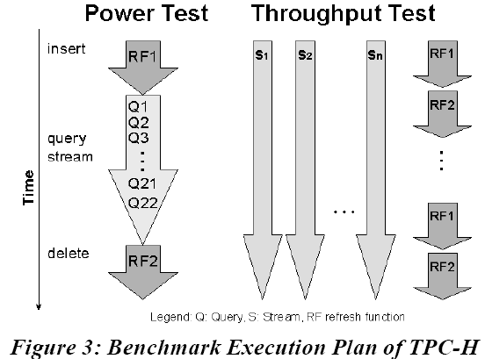

Slide 21
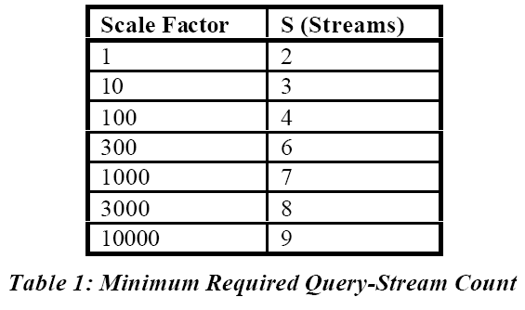

Slide 22
The Processing Power
Power@Size
  The geometric mean of the elapsed times for all queries and both refresh functions obtained from the power test.
  The unit is queries per hour.

Slide 23
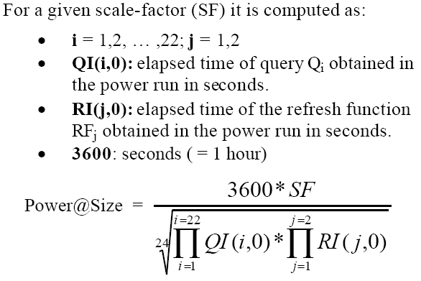
Computation of Power@Size

Slide 24
The Throughput Power
Throughput@Size
  The ratio of the total number of queries executed over the length of the measurement interval of the multi-stream run.
  The unit is queries per hour.

Slide 25
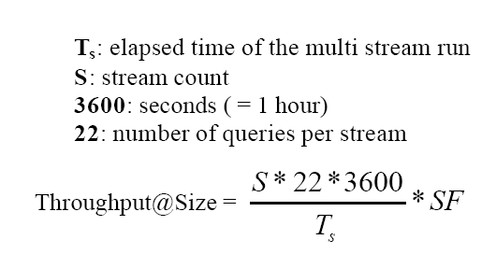
Computation of Throughput@Size

Slide 26
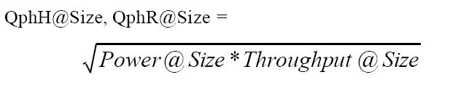
The Composite Query-Per-Hour Performance Metric

Slide 27
Price/Performance Metric
The ratio of the total system price divided by the composite metric QphH@Size.

Slide 28
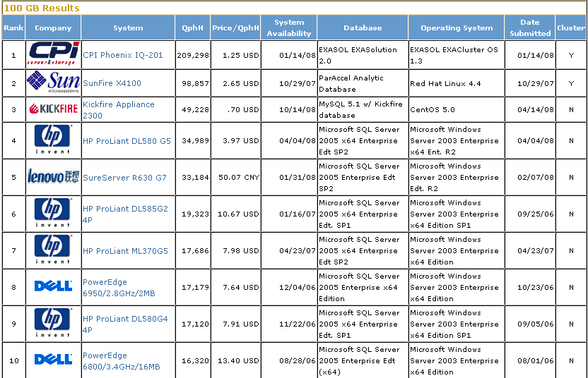
Top Ten TPC-H by Performance:
Version 2 Results As of 19-Mar-2009 3:48 AM

Slide 29
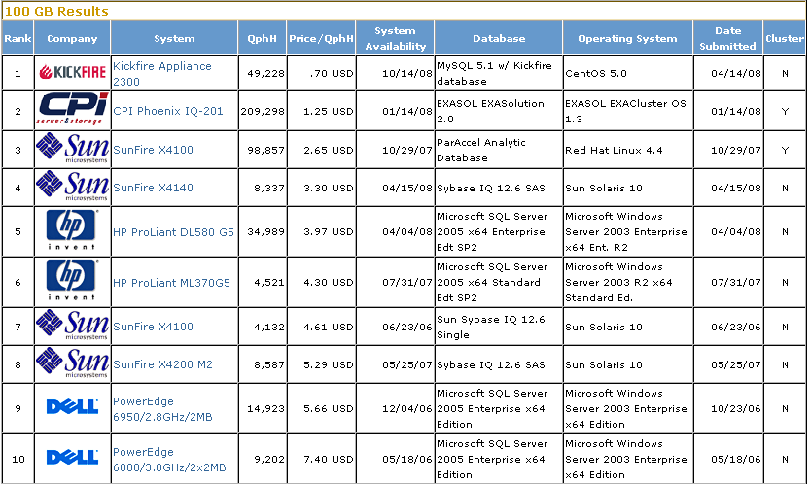
Top Ten TPC-H by Price/Performance:
Version 2 Results As of 19-Mar-2009 3:51 AM

Slide 30
References
M. Poess, C. Floyd . New TPC Benchmarks for Decision Support and Web Commerce . ACM SIGMOD Record, 29(4) December 2000.
TPC-H Official Site: http://www.tpc.org/tpch/
TPC-H Version 2.8.0 : http://www.tpc.org/tpch/spec/tpch2.8.0.pdf

